Slide 1


Harvest-X
Project Team: Joshua Bailey, Jair Dunham, Autumn Fields,Christina McWilliams

Slide 2

Problem Definition
Solution Approach
Program Structure
Program Logistics
Testing and Validation
Application Demonstration
Conclusion
Presentation Overview

Slide 3



Problem Definition
Each month the Aggie Source food pantry reports the number of individuals and households served to the Second Harvest food pantry.
The current process requires merging data across multiple spreadsheets and using several excel formulas to create the final result.
Info to Report | Rules
Unduplicated Households | Count the number of names in the participation history spreadsheet. Based on name, determine if there are people that have the same address and if they live off-campus. If there are people in the list with the same address and they live off campus, they count as one household. All other names with unique addresses are counted as one household. Report the total.
Unduplicated Individuals | Count the unique names in the participation history. The total number is the unduplicated individuals.
Total Households | The total participation history (even if a person from a household was served multiple times).
Total Individuals | The total number of people (even if a person was served multiple times) and is equal to total households.

Slide 4
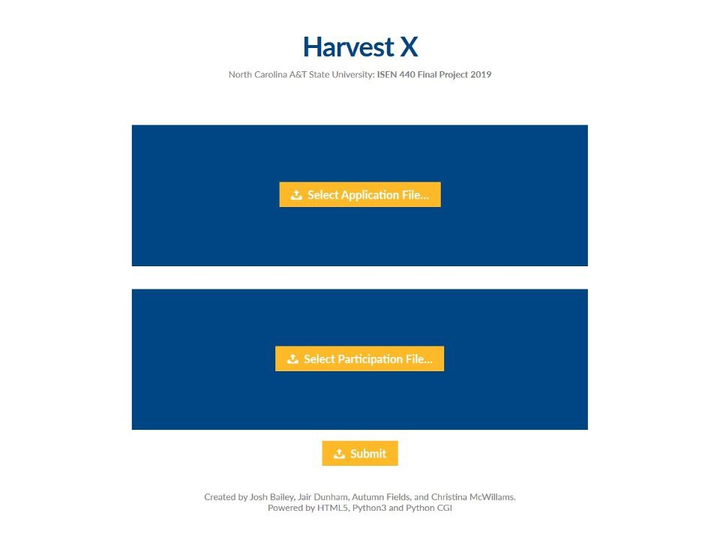
Program Structure
Project Approach
The upload…
Uploads the file entered by the user.
Several security protocols to prevent directory traversal
Renames the file. (Eliminates file exist checking, saves space)

Slide 5
Program Structure
Project Approach
The dictionary…
Takes the emails from the participation file, and inputs them into a dictionary
{‘Key: auto incremented number’:{Value: email}}
Then takes the emails and address’s from the application file and inputs them into dictionary
{‘Key: email’:{Value: address}}
Inverts the dictionaries. Dictionaries can not have duplicate keys. This causes the program to merge participation emails into one key, with the value showing each occurrence of the participant. The program also merges addresses into one key, with the value showing the emails assigned to the address
Next, the program compares the reversed participation dictionary with the addresses from the original application dictionary and creates a new address dictionary from those results.
{‘Key: email of participants’:{Value: their address}}

Slide 6
Program Structure
Project Approach
The program…
From our logic, we were able to obtain the individual household count from the result of the reversed application dictionary and participation dictionary comparison (length of address dictionary).
We were able to obtain the total participant count from the original participation dictionary (length of participation dictionary).
We were able to obtain the unique individuals from the reversed participation dictionary (length of reversed participation dictionary).

Slide 7
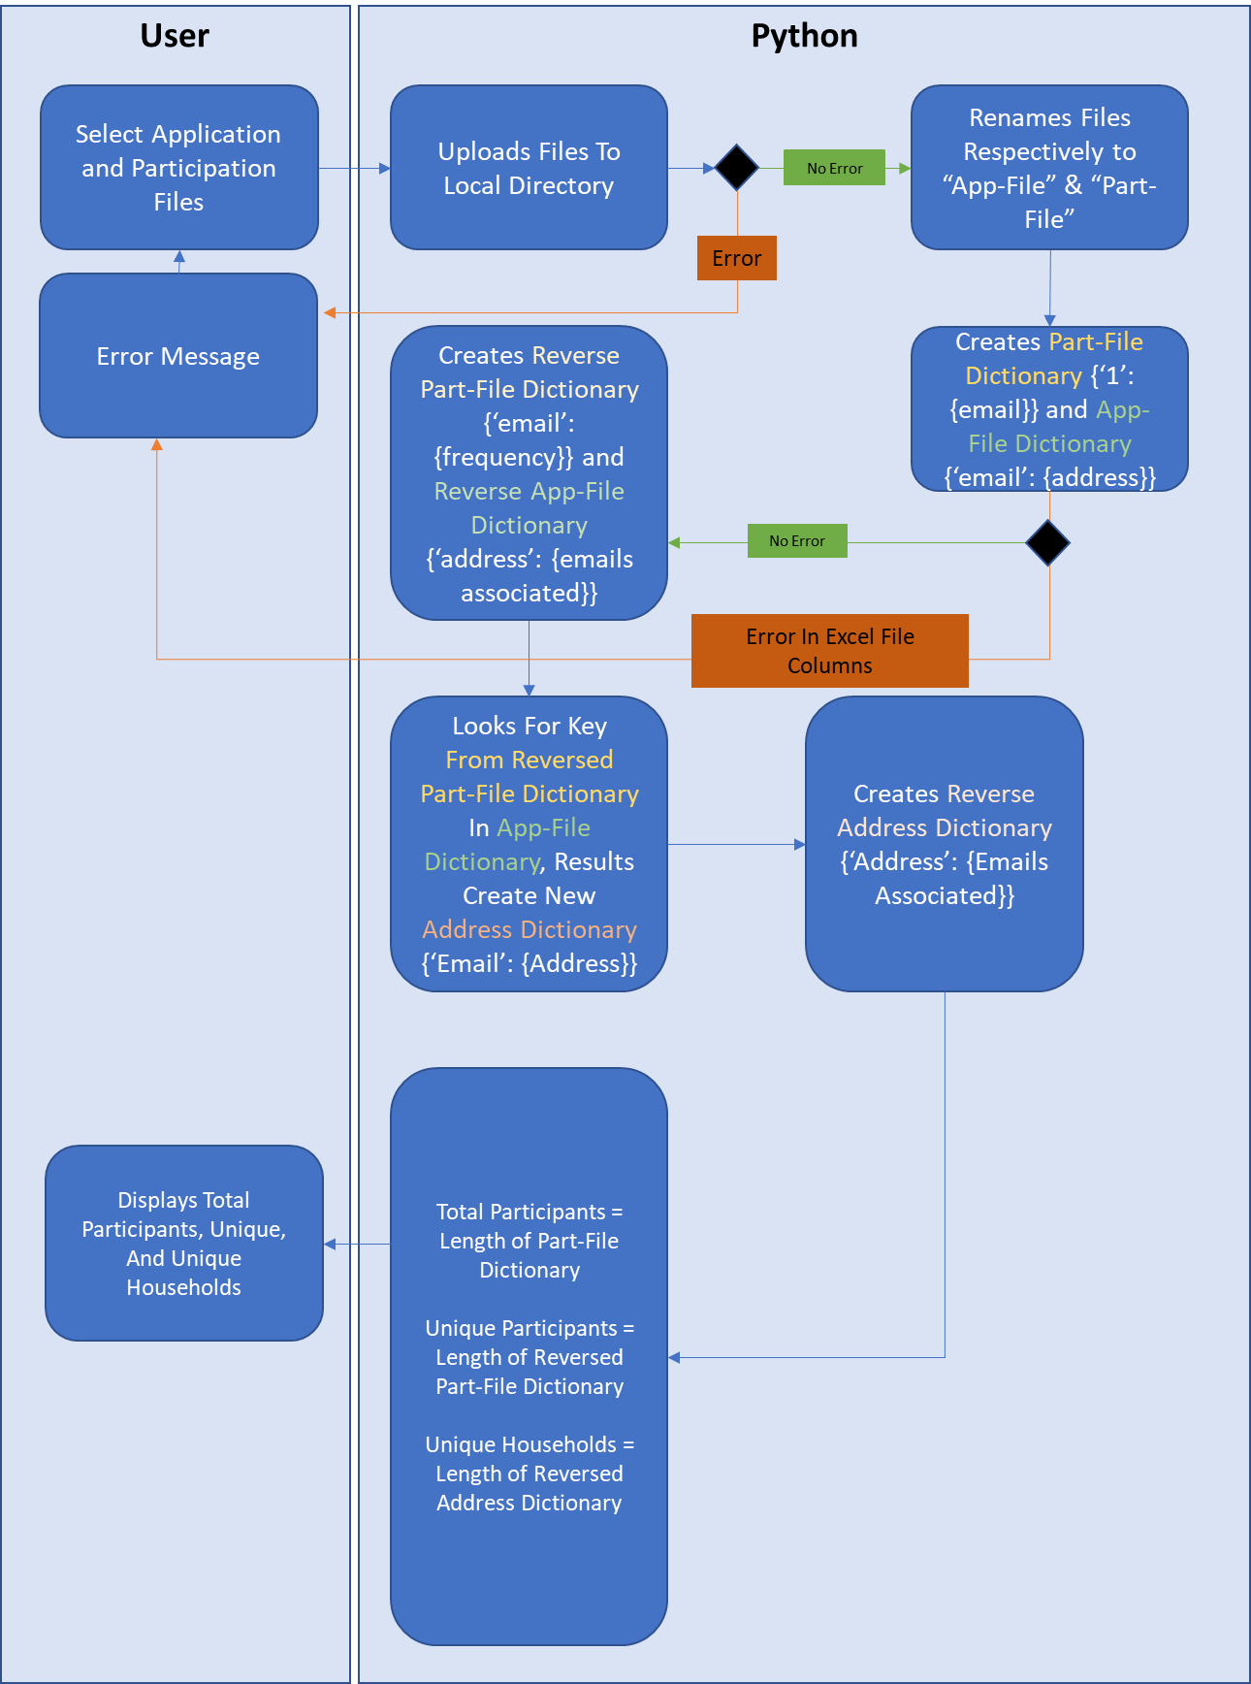

UML Activity Diagram
No Error
Error
Flow

Slide 8
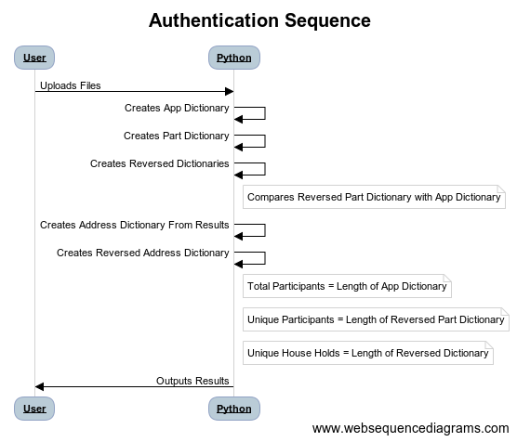
UML Structure Diagram

Slide 9
Testing and Validation
Test Case Scenario Exp. Result
Path 1 Valid File & Columns Print Result Path 2 File Not Valid Error Message Path 3 Columns Incorrect Error Message
Program was developed with minimal chance for errors

Slide 10
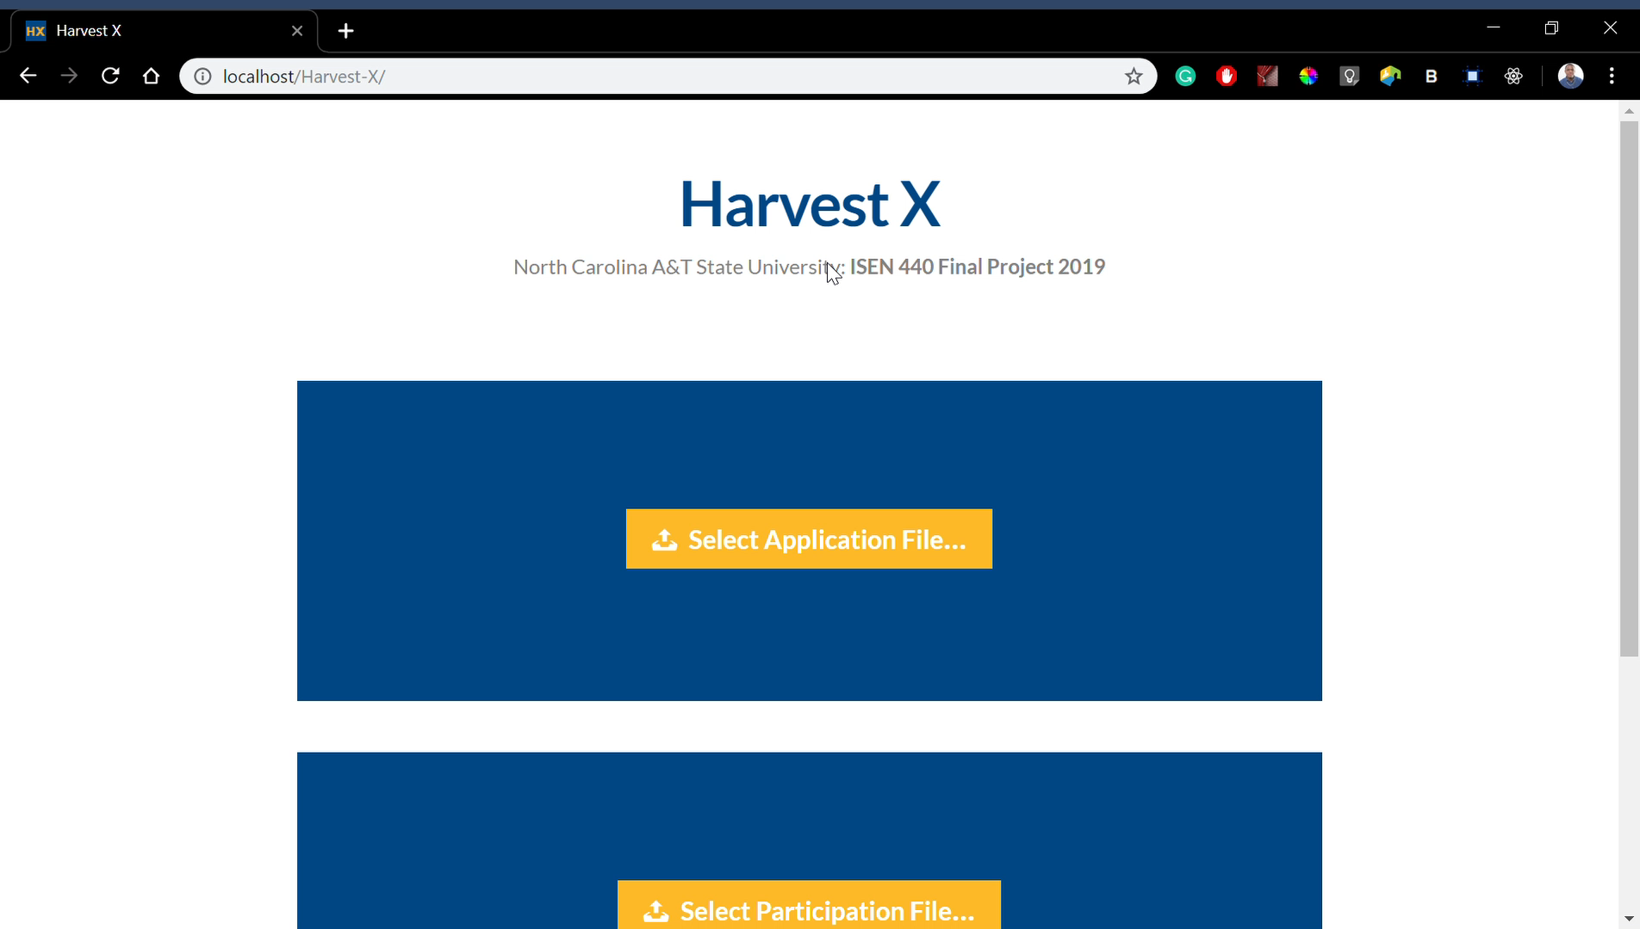

Application Demo

Slide 11




Coding Platforms:
Conclusion
Application and Participation excel files were ingrained with macro code to isolate and pair the emails with their home addresses in the excel sheet. The amount of trials using the code to get it to work was numerous. Once it worked, the files were saved to be used for input into the python program. Dictionaries were created linking the emails of the participation file with the emails and addresses of the application files. It helped to narrow down any outliers in the files. Each line of code was tested prior to completion with the insertion of the excel files. When the individuals’ were grouped based on their shared addresses, it would return with the total number of households and people in those houses.

Slide 12
Goal: Unique households, unique individuals, and total participants returned
Conclusion
We designed a python program that is able to obtain the individual households from excel file inputs. Ultimately, the files were coded with macro to pair either application or participant files with emails and addresses together. Given individual emails are unique to their name, the two were linked through the creation of dictionaries with addresses. These elements are most important in accomplishing the program mission.
As an end result, the program groups the emails together that share the same home address. This shows the people that share one household with unduplicated individuals. The total individuals that share a home address will be returned.

Slide 13
What we learned through the course of this project

